Slide 2
Configuring Build Pipelines

Slide 3

By the end of this lesson, you'll be able to:
Define CI/CD Pipeline
Differentiate build jobs and Pipelines
Create a Continuous Integration Pipeline
Explain the Declarative Pipeline Syntax
Build a Pipeline from a Jenkinsfile
Notes:
Trainer Notes: Introduce the topics

Slide 4
Introducing Pipelines

Slide 5
Pipelines
Jenkins Pipeline is a suite of plugins which supports implementing and integrating continuous delivery Pipelines into Jenkins.
It is basically Jenkins jobs enabled by the Pipeline plugin.
A Continuous Delivery (CD) Pipeline is an automated expression of your process for getting software from version control right through to your users and customers.
Notes:
Trainer Notes: Explain the slide and mention the points below
Pipeline in DevOps:
A pipeline in a Software Engineering team is a set of automated processes that allow Developers and DevOps professionals to reliably and efficiently compile, build and deploy their code to their production compute platforms.
Pipeline in Jenkins:
formerly called “workflow”.
They are built with simple text scripts that use a Pipeline DSL domain-specific language based on the Groovy programming language.

Slide 6
Why Pipeline?
Freestyle jobs do not create a persistent record of execution, allow one script to address all the steps in a complex workflow, or have the other advantages of Pipelines.
In contrast, Pipelines enable you to define the whole application lifecycle.
Pipeline functionality helps Jenkins to support continuous delivery (CD).
The Pipeline plugin was built with requirements for a flexible, extensible, and script-based CD workflow capability in mind.
Notes:
Trainer Notes: Explain the slide

Slide 7
Advantages of Pipelines
Extensible:
The Pipeline plugin supports custom extensions to its DSL and multiple options for
integration with other plugins.
Durable:
Pipelines can survive both planned and unplanned restarts of Jenkins master.
2
Pausable:
Pipelines can optionally stop and wait for human input or approval before completing the
jobs for which they were built.
Efficient:
Pipelines can restart from any of several saved checkpoints.
Versatile:
Pipelines support complex real-world CD requirements, including the ability to fork or join, loop, and work in parallel with each other.
Notes:
Trainer Notes: Explain the slide and mention the points below
Pipelines have the following advantages:
Durable:
Pipelines can survive both planned and unplanned restarts of Jenkins master.
Pausable:
Pipelines can optionally stop and wait for human input or approval before completing the
jobs for which they were built.
Versatile:
Pipelines support complex real-world CD requirements, including the ability to fork or join, loop, and work in parallel with each other.
Efficient:
Pipelines can restart from any of several saved checkpoints.
Extensible:
The Pipeline plugin supports custom extensions to its DSL and multiple options for
integration with other plugins.

Slide 8
Understanding Pipeline Structure

Slide 9
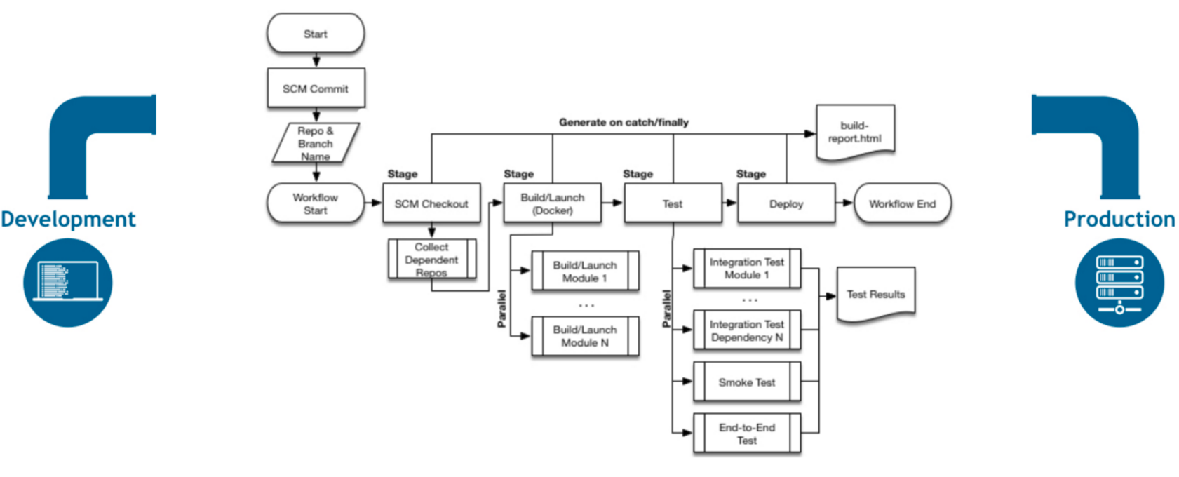
Pipeline Workflow
The flowchart below shows a Continuous Delivery scenario enabled by the Pipeline plugin:
Notes:
Trainer Notes: Explain the slide

Slide 10
Pipeline Terminology
Here are a few keywords in the Jenkins Pipeline and their definitions:
Pipeline:
A Pipeline is a user-defined model of a CD pipeline.
A Pipeline’s code defines your entire build process, which typically includes stages for building an application, testing it, and then delivering it.
Node:
A node is a machine which is part of the Jenkins environment and is capable of executing a Pipeline.
Notes:
Trainer Notes: Explain the slide

Slide 11
Pipeline Terminology
Here are a few keywords in the Jenkins Pipeline and their definitions:
Stage:
A stage block defines a conceptually distinct subset of tasks performed through the entire Pipeline.
For example: Build, Test, and Deploy
Step:
A step is a single task.
A step tells Jenkins what to do at a particular point in time.
For example: checkout code from repository or execute a script
Notes:
Trainer Notes: Explain the slide and mention the points below
It's possible to create parallel steps; however, it's better to treat it as an exception when really needed for optimization purposes.

Slide 12
Defining a Pipeline

Slide 13
Defining a Pipeline
Pipeline provides an extensible set of tools for modeling simple-to-complex delivery pipelines as code via the Pipeline Domain-Specific Language (DSL) syntax.
The definition of a Jenkins Pipeline is written into a text file called a Jenkinsfile.
A Jenkinsfile can be written using two types of syntax: Declarative and Scripted.
Both Declarative and Scripted Pipeline are DSLs to describe portions of your software delivery pipeline.
Notes:
Trainer Notes: Explain the slide

Slide 14
Benefits of Jenkinsfile
Creates a single source of truth for the Pipeline, which can be viewed and edited by multiple members of the project.
Automatically creates a Pipeline build process for all branches and pull requests.
Jenkinsfile
Leaves an audit trail for the Pipeline.
Undergoes code review/iteration on the Pipeline along with the remaining source code.
Notes:
Trainer Notes: Explain the slide

Slide 15
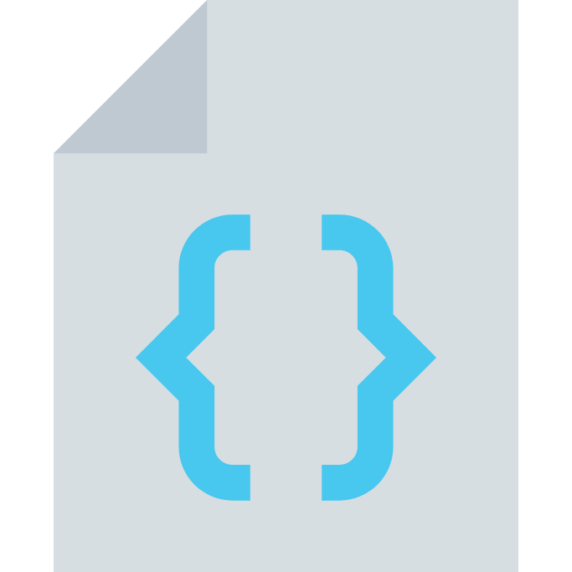
Scripted vs. Declarative Syntax
Scripted Pipeline is written in a limited form of Groovy syntax. Declarative Pipelines are constructed differently.
Declarative Pipeline is more recent.
Declarative Pipeline provides richer syntactical features over Scripted Pipeline syntax.
Declarative Pipeline is designed to make writing and reading Pipeline code easier.
Notes:
Trainer Notes: Explain the slide

Slide 16
Declarative Pipeline Syntax

Slide 17
Declarative Pipeline Syntax
In Declarative Pipeline syntax, the Pipeline block defines all the work done throughout your entire Pipeline. The box below shows the Declarative Pipeline syntax:
Jenkinsfile (Declarative Pipeline)
Pipeline {
agent any
stages {
stage('Build') {
steps {
//
}
}
stage('Test') {
steps {
//
}
}
stage('Deploy') {
steps {
//
}
}
}
}
Notes:
Trainer Notes: Explain the slide

Slide 18
Declarative Pipeline Syntax
In Declarative Pipeline syntax, the Pipeline block defines all the work done throughout your entire Pipeline. The box below shows the Declarative Pipeline syntax:
Jenkinsfile (Declarative Pipeline)
Pipeline {
agent any
stages {
stage('Build') {
steps {
//
}
}
stage('Test') {
steps {
//
}
}
stage('Deploy') {
steps {
//
}
}
}
}
Execute this Pipeline or any of its stages, on any available agent.
Notes:
Trainer Notes: Explain the slide

Slide 19
Declarative Pipeline Syntax
In Declarative Pipeline syntax, the Pipeline block defines all the work done throughout your entire Pipeline. The box below shows the Declarative Pipeline syntax:
Jenkinsfile (Declarative Pipeline)
Pipeline {
agent any
stages {
stage('Build') {
steps {
//
}
}
stage('Test') {
steps {
//
}
}
stage('Deploy') {
steps {
//
}
}
}
}
Defines the Build stage.
Notes:
Trainer Notes: Explain the slide

Slide 20
Declarative Pipeline Syntax
In Declarative Pipeline syntax, the Pipeline block defines all the work done throughout your entire Pipeline. The box below shows the Declarative Pipeline syntax:
Jenkinsfile (Declarative Pipeline)
Pipeline {
agent any
stages {
stage('Build') {
steps {
//
}
}
stage('Test') {
steps {
//
}
}
stage('Deploy') {
steps {
//
}
}
}
}
Perform some steps related to the Build stage.
Notes:
Trainer Notes: Explain the slide

Slide 21
Declarative Pipeline Syntax
In Declarative Pipeline syntax, the Pipeline block defines all the work done throughout your entire Pipeline. The box below shows the Declarative Pipeline syntax:
Jenkinsfile (Declarative Pipeline)
Pipeline {
agent any
stages {
stage('Build') {
steps {
//
}
}
stage('Test') {
steps {
//
}
}
stage('Deploy') {
steps {
//
}
}
}
}
Defines the Test stage.
Notes:
Trainer Notes: Explain the slide

Slide 22
Declarative Pipeline Syntax
In Declarative Pipeline syntax, the Pipeline block defines all the work done throughout your entire Pipeline. The box below shows the Declarative Pipeline syntax:
Jenkinsfile (Declarative Pipeline)
Pipeline {
agent any
stages {
stage('Build') {
steps {
//
}
}
stage('Test') {
steps {
//
}
}
stage('Deploy') {
steps {
//
}
}
}
}
Perform some steps related to the Test stage.
Notes:
Trainer Notes: Explain the slide

Slide 23
Declarative Pipeline Syntax
In Declarative Pipeline syntax, the Pipeline block defines all the work done throughout your entire Pipeline. The box below shows the Declarative Pipeline syntax:
Jenkinsfile (Declarative Pipeline)
Pipeline {
agent any
stages {
stage('Build') {
steps {
//
}
}
stage('Test') {
steps {
//
}
}
stage('Deploy') {
steps {
//
}
}
}
}
Defines the Deploy stage.
Notes:
Trainer Notes: Explain the slide

Slide 24
Declarative Pipeline Syntax
In Declarative Pipeline syntax, the Pipeline block defines all the work done throughout your entire Pipeline. The box below shows the Declarative Pipeline syntax:
Jenkinsfile (Declarative Pipeline)
Pipeline {
agent any
stages {
stage('Build') {
steps {
//
}
}
stage('Test') {
steps {
//
}
}
stage('Deploy') {
steps {
//
}
}
}
}
Perform some steps related to the Deploy stage.
Notes:
Trainer Notes: Explain the slide

Slide 25
Declarative Pipeline Syntax
The declarative syntax was designed to make Pipeline building simple. This is why the syntax is limited only to some important keywords.
A declarative Pipeline is always specified inside the Pipeline block and contains:
Sections
Directives
Steps
The complete Pipeline syntax description can be found on the official Jenkins page at https:/​/​jenkins.​io/​doc/​book/​Pipeline/​syntax/​.
Notes:
Trainer Notes: Explain the slide

Slide 26
Declarative Pipeline Syntax
The code block below shows a sample Pipeline script:
Pipeline {
agent any
triggers { cron('* * * * *') }
options { timeout(time: 5) }
parameters {
booleanParam(name: 'DEBUG_BUILD', defaultValue: true,
description: 'Is it the debug build?')
}
stages {
stage('Example') {
environment { NAME = 'Simplilearn' }
when { expression { return params.DEBUG_BUILD } }
steps {
echo "Hello from $NAME"
script {
def browsers = ['chrome', 'firefox']
for (int i = 0; i < browsers.size(); ++i) {
echo "Testing the ${browsers[i]} browser."
}
}
}
}
}
post { always { echo 'Hello again!' } }
}
Notes:
Trainer Notes: Explain the slide and mention the points below
The instructions in this Pipeline script are the following:
Use any available agent.
Execute automatically every minute.
Stop if the execution takes more than five minutes.
Ask for the Boolean input parameter before starting.
Set Simplilearn as the environment variable NAME.
Only in the case of the true input parameter:
Print Hello from Simplilearn
Print Testing the chrome browser
Print Testing the firefox browser
Print Hello again! regardless of errors during the execution.

Slide 27
Pipeline Keywords
Here are the important keywords in the Pipeline syntax and their meanings:
Sections:
Sections define the Pipeline structure and usually contain one or more directives or steps.
They are defined with the following keywords:
Stages: This defines a series of one or more stage directives
Steps: This defines a series of one or more step instructions
Post: This defines a series of one or more step instructions that are run at the end of the Pipeline build. It is marked with a condition and is usually used to send notifications after the Pipeline build.
Notes:
Trainer Notes: Explain the slide

Slide 28
Pipeline Keywords
Directives express the configuration of a Pipeline or its parts. They are:
Agent: This specifies where the execution takes place. It can define the label to match the equally labeled agents or docker to specify a container that is dynamically provisioned to provide an environment for the Pipeline execution.
Triggers: This defines automated ways to trigger the Pipeline. It can use cron to set the time-based scheduling or poll SCM to check the repository for changes.
Options: This specifies Pipeline-specific options. For example: timeout or retry
Environment: This defines a set of key values used as environment variables during the build.
Parameters: This defines a list of user-input parameters.
Stage: This allows for logical grouping of steps.
When: This determines whether the stage should be executed depending on the given condition.
Notes:
Trainer Notes: Explain the slide

Slide 29
Pipeline Keywords
Steps: are the most fundamental part of the Pipeline. The keywords used in steps are:
sh:
This executes the shell commands.
It's possible to define almost every operation using sh.
custom:
Jenkins offers a lot of operations that can be used as steps.
Many of them are simple wrappers over the sh command used for convenience.
Plugins can also define their own operations.
script:
This executes a block of the Groovy-based code that can be used for some non-trivial scenarios, where flow control is needed.
Notes:
Trainer Notes: Explain the slide and mention the points below
Steps define the operations that are executed.

Slide 30
Scripted Pipeline Syntax

Slide 31
Scripted Pipeline Syntax
In Scripted Pipeline syntax, one or more node blocks do the core work throughout the entire Pipeline.
A node is a machine which is part of the Jenkins environment and is capable of executing a Pipeline.
This is not a mandatory requirement of Scripted Pipeline syntax.
This schedules the steps contained within the block to run by adding an item to the Jenkins queue. As soon as an executor is free on a node, the steps will run.
This creates a workspace where the files checked out from source control can be worked on.
Advantages of confining your Pipeline’s work inside of a node block
Notes:
Trainer Notes: Explain the slide

Slide 32
Scripted Pipeline Syntax
The box below shows the Scripted Pipeline syntax:
Jenkinsfile (Scripted Pipeline)
node {
stage('Build') {
//
}
stage('Test') {
//
}
stage('Deploy') {
//
}
}
Execute this Pipeline or any of its stages, on any available agent.
Defines the Build stage. Stage blocks are optional in Scripted Pipeline syntax.
Perform some steps related to the Build stage.
Defines the Test stage.
Defines the Deploy stage.
Perform some steps related to the Test stage.
Perform some steps related to the Deploy stage.
Notes:
Trainer Notes: Explain the slide

Slide 33
Pipeline
Problem Statement: You have been asked to configure the Jenkins instance to include the Pipeline functionality and test it.
Steps to perform:
Configure the Pipeline plugin in Jenkins
Create a Pipeline
Test run the Pipeline

Slide 34
Building a Pipeline

Slide 35
Building a Pipeline
There are three ways to create a Pipeline:
Through Blue Ocean
Through the classic UI
Through Jenkinsfile
Notes:
Trainer Notes: Explain the slide

Slide 36
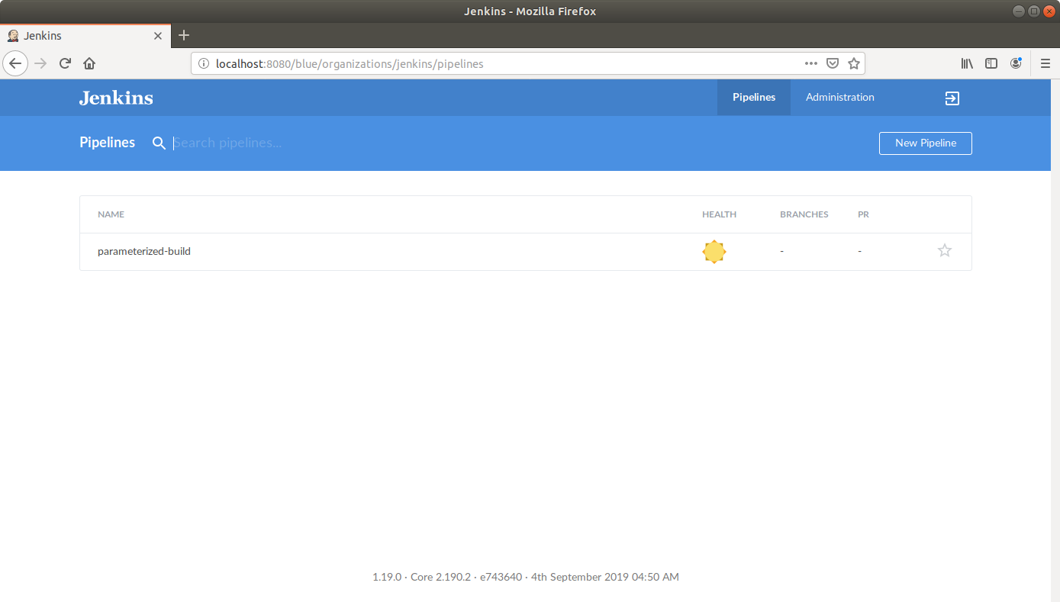
Building Pipelines with Blue Ocean
The screenshot below shows the Blue Ocean dashboard:
Notes:
Trainer Notes: Explain the slide

Slide 37
Building Pipelines with Blue Ocean
The Blue Ocean UI helps you set up your Pipeline project, and automatically creates your Pipeline, that is, the Jenkinsfile through the graphical Pipeline editor.
Jenkins configures a secure and appropriately authenticated connection to your project’s source control repository.
Any changes you make to the Jenkinsfile via Blue Ocean’s Pipeline editor are automatically saved and committed to source control.
Click on the New Pipeline button in the Blue Ocean Dashboard to create a new Pipeline.
Notes:
Trainer Notes: Explain the slide

Slide 38
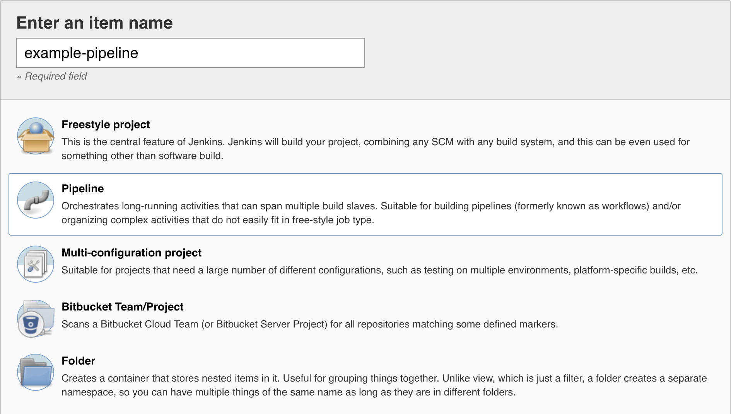
Building Pipelines with the Classic UI
The screenshot below shows the Classic UI:
Notes:
Trainer Notes: Explain the slide

Slide 39
Building Pipelines with the Classic UI
A Jenkinsfile created using the classic UI is stored by Jenkins itself, within the Jenkins home directory. To create a basic Pipeline through the Jenkins classic UI:
Click New Item at the top left in the Jenkins Dashboard.
Specify the name for your new Pipeline project in the Enter an item name field.
Scroll down and click Pipeline, click OK at the end of the page to open the Pipeline configuration page.
Click the Pipeline tab at the top of the page to scroll down to the Pipeline section.
Ensure that the Definition field indicates the Pipeline script option in the Pipeline section.
Enter your Pipeline code into the Script text area.
Click Save to open the Pipeline project/item view page.
Click Build Now on the left to run the Pipeline.
Notes:
Trainer Notes: Explain the slide

Slide 40
Continuous Integration Pipeline

Slide 41
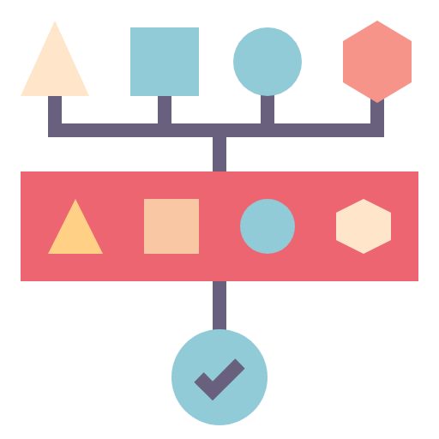
Commit Pipeline
The most basic Continuous Integration process is a commit Pipeline.
This phase starts with a commit or a push to the main repository and ends with a report about the build success or failure.
The Pipeline runs after each change in the code, takes no more than five minutes, and consumes a reasonable amount of resources.
The commit phase is always the starting point of the Continuous Delivery process, and it provides the most important feedback cycle in the development process.
Notes:
Trainer Notes: Explain the slide

Slide 42
Commit Pipeline
The commit phase works as follow:
A developer checks in the code to the repository.
The Continuous Integration server detects the change.
The build starts.
The commit Pipeline contains three stages:
Checkout: This stage downloads the source code from the repository.
Compile: This stage compiles the source code.
Unit test: This stage runs a suite of unit tests.
Notes:
Trainer Notes: Explain the slide

Slide 43
Continuous Integration Pipelines
Problem Statement: You are given a Java project. Build a Continuous Integration Pipeline in Jenkins for the commit.
Steps to perform:
Create a GitHub repository
Define a checkout stage
Create a Java Spring Boot project
Push code to GitHub
Define a compile stage
Write a unit test
Define a unit test stage
Run and test the Pipeline

Slide 44
Building Pipelines from Jenkinsfile

Slide 45
Jenkinsfile
The Pipeline definition in the Jenkinsfile can be committed to the repository along with the source code.
This method is more consistent as the Pipeline structure becomes strongly tailored to the project.
For example: if you don't need the code compilation because your programming language is interpreted, then you won't have the Compile stage.
Notes:
Trainer Notes: Explain the slide and mention the points below
The tools you use also differ depending on the environment. We used Gradle/Maven because we've built the Java project; however, in the case of a project written in Python, you could use PyBuilder. It leads to the idea that the Pipelines should be created by the same people who write the code, developers. Also, the Pipeline definition should be put together with the code, in the repository.

Slide 46
Creating Jenkinsfile
A Jenkinsfile for a commit will have almost the same content as the commit Pipeline.
The only difference will be that the checkout stage becomes redundant because Jenkins has to checkout the code as well as the Jenkinsfile and then read the Pipeline structure from the Jenkinsfile.
Jenkins needs to know the repository address before it reads Jenkinsfile.
Once the Jenkinsfile is created, you can push it to the GitHub repository.
Notes:
Trainer Notes: Explain the slide

Slide 47
Creating Jenkinsfile
Here is a sample Jenkinsfile for a commit Pipeline:
Pipeline {
agent any stages {
stage("Compile") {
steps {
sh "./gradlew compileJava"
}
}
stage("Unit test") {
steps {
sh "./gradlew test"
}
}
}
}
Notes:
Trainer Notes: Explain the slide

Slide 48
Running Pipeline from Jenkinsfile
After the Jenkinsfile is pushed, we can run the Pipeline as given below:
After saving, the build will always run from the current version of Jenkinsfile in the repository.
Open the Pipeline configuration.
Change Definition from Pipeline script to Pipeline script from SCM.
Select Git in SCM.
Enter Repository URL.
Save the Pipeline.
Notes:
Trainer Notes: Explain the slide and mention the points below
Each successful Pipeline run will have associated build artifacts archived, test results reported upon, and the full console output all in Jenkins.

Slide 49
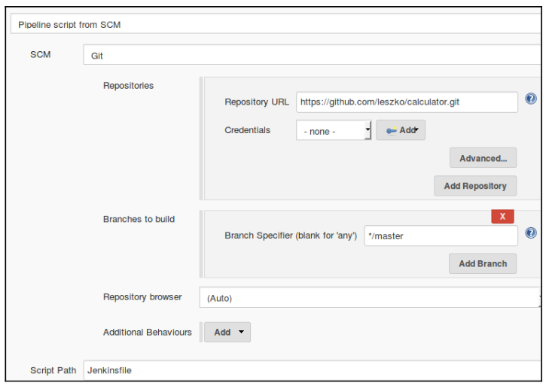
Running Pipeline from Jenkinsfile
The screenshot below shows how to run a Pipeline from a Jenkinsfile:
Notes:
Trainer Notes: Explain the slide

Slide 50
Build with Jenkinsfile
The Build stage of the Pipeline will be where source code is assembled, compiled, or packaged.
The Jenkinsfile is not a replacement for an existing build tool such as GNU/Make, Maven, Gradle, etc.
It can be considered a glue layer to bind the multiple phases of a project’s development lifecycle like build, test, and deploy together.
Jenkins has plugins for invoking practically any build tool.
Notes:
Trainer Notes: Explain the slide

Slide 51
Test with Jenkinsfile
Running automated tests is a crucial component of any successful continuous delivery process.
Jenkins has a number of test recording, reporting, and visualization facilities provided by a number of plugins.
The example below uses the JUnit step, provided by the JUnit plugin. If tests fail, the Pipeline is marked unstable.
Jenkinsfile (Declarative Pipeline)
pipeline {
agent any
stages {
stage('Test') {
steps {
/* `make check` returns non-zero on test failures,
* using `true` to allow the Pipeline to continue nonetheless
*/
sh 'make check || true'
junit '**/target/*.xml'
}
}
}
}
Notes:
Trainer Notes: Explain the slide and mention the points below
Jenkins record the failures for reporting and visualization in the web UI, when there are test failures.

Slide 52
Deploy with Jenkinsfile
Deployment can be anything from publishing built artifacts to an Artifactory server, to pushing code to a production system.
The example below shows a Deploy Pipeline. At this stage of the example Pipeline, both the Build and Test stages have been successfully executed.
Jenkinsfile (Declarative Pipeline)
pipeline {
agent any
stages {
stage('Deploy') {
when {
expression {
currentBuild.result == null || currentBuild.result == 'SUCCESS'
}
}
steps {
sh 'make publish'
}
}
}
}
Notes:
Trainer Notes: Explain the slide

Slide 53
Jenkinsfile
Problem Statement: You are given a Java project. Create a Jenkinsfile to build a CI Pipeline.
Steps to perform:
Create a Maven project
Create a Jenkinsfile with stages for checkout, compile, and test
Push the code and Jenkinsfile to GitHub
Define a Pipeline to build the project

Slide 54
Snippet Generator

Slide 55
Snippet Generator
The Snippet Generator helps create Pipeline script by auto-generating steps.
The Snippet Generator is dynamically populated with a list of the steps available to the Jenkins instance.
It is useful for:
Creating bits of code for individual steps
Discovering new steps provided by plugins
Experimenting with different parameters for a particular step
Notes:
Trainer Notes: Explain the slide and mention the points below
The number of steps available depends on the plugins installed.

Slide 56
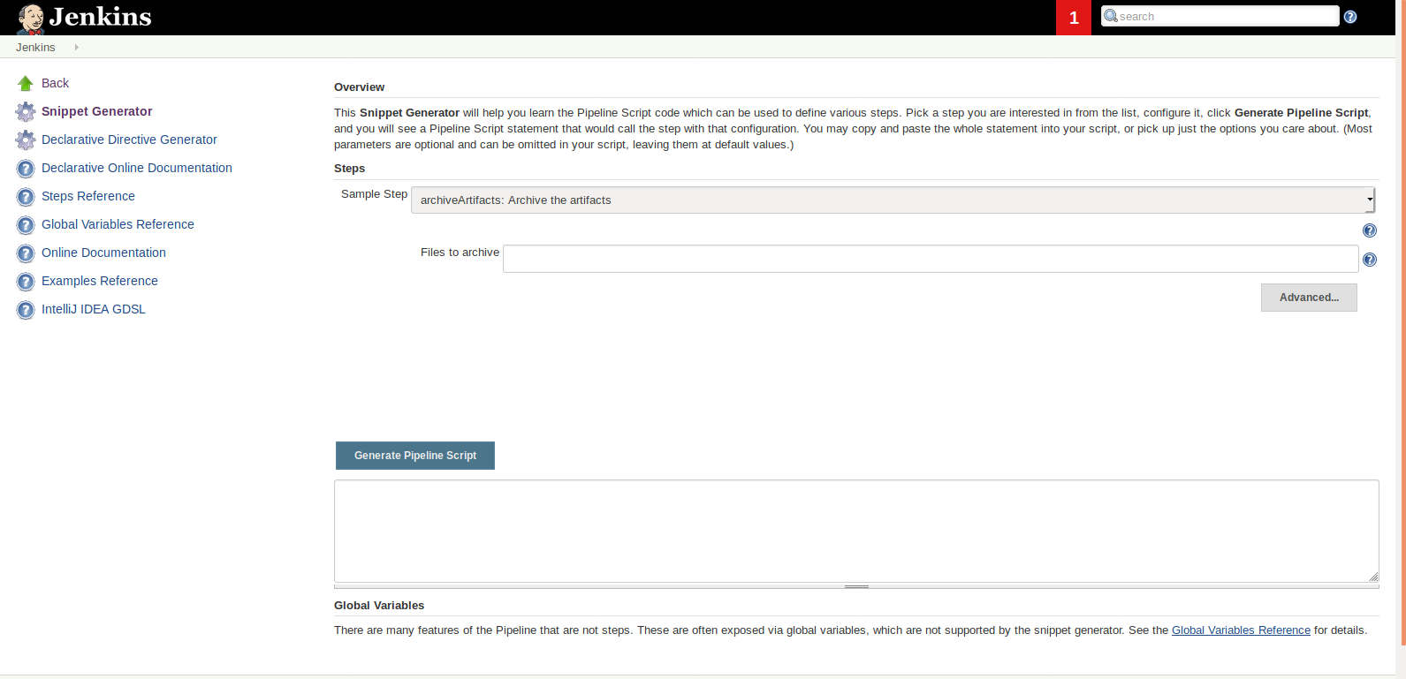
Snippet Generator
The screenshot below shows the Snippet Generator:
Notes:
Trainer Notes: Explain the slide

Slide 57
Snippet Generator
Steps to generate a step snippet with the Snippet Generator:
01
02
03
04
Navigate to the Pipeline Syntax link at ${YOUR_JENKINS_URL}/pipeline-syntax.
Select the desired step in the Sample Step dropdown menu.
Use the dynamically populated area below the Sample Step dropdown to configure the selected step.
Click Generate Pipeline Script to create a snippet of Pipeline which can be copied and pasted into a Pipeline.
Notes:
Trainer Notes: Explain the slide

Slide 58
Snippet Generator
Problem Statement: Define a Pipeline using the Snippet Generator
Steps to perform:
Navigate to ${YOUR_JENKINS_URL}/pipeline-syntax.
Select a step in the Sample Step dropdown menu.
Use the dynamically populated area to configure the selected step.
Create a snippet of Pipeline.

Slide 59
Global Variable Reference

Slide 60
Global Variable Reference
Pipeline also provides a built-in Global Variable Reference.
It is also dynamically populated by plugins.
The Global Variable Reference only contains documentation for variables provided by Pipeline or plugins, which are available for Pipelines.
The built-in global variable reference at ${YOUR_JENKINS_URL}/pipeline-syntax/globals gives a complete list of environment variables available in Pipeline.
Notes:
Trainer Notes: Explain the slide

Slide 61
Global Variable Reference
The variables provided by default in Pipeline are:
env:
Environment variables accessible from Scripted Pipeline, for example: env.PATH or env.BUILD_ID.
params:
Exposes all parameters defined for the Pipeline as a read-only Map.
For example: params.MY_PARAM_NAME.
currentBuild:
May be used to discover information about the currently executing Pipeline, with properties such as currentBuild.result, currentBuild.displayName, etc.
Notes:
Trainer Notes: Explain the slide

Slide 62
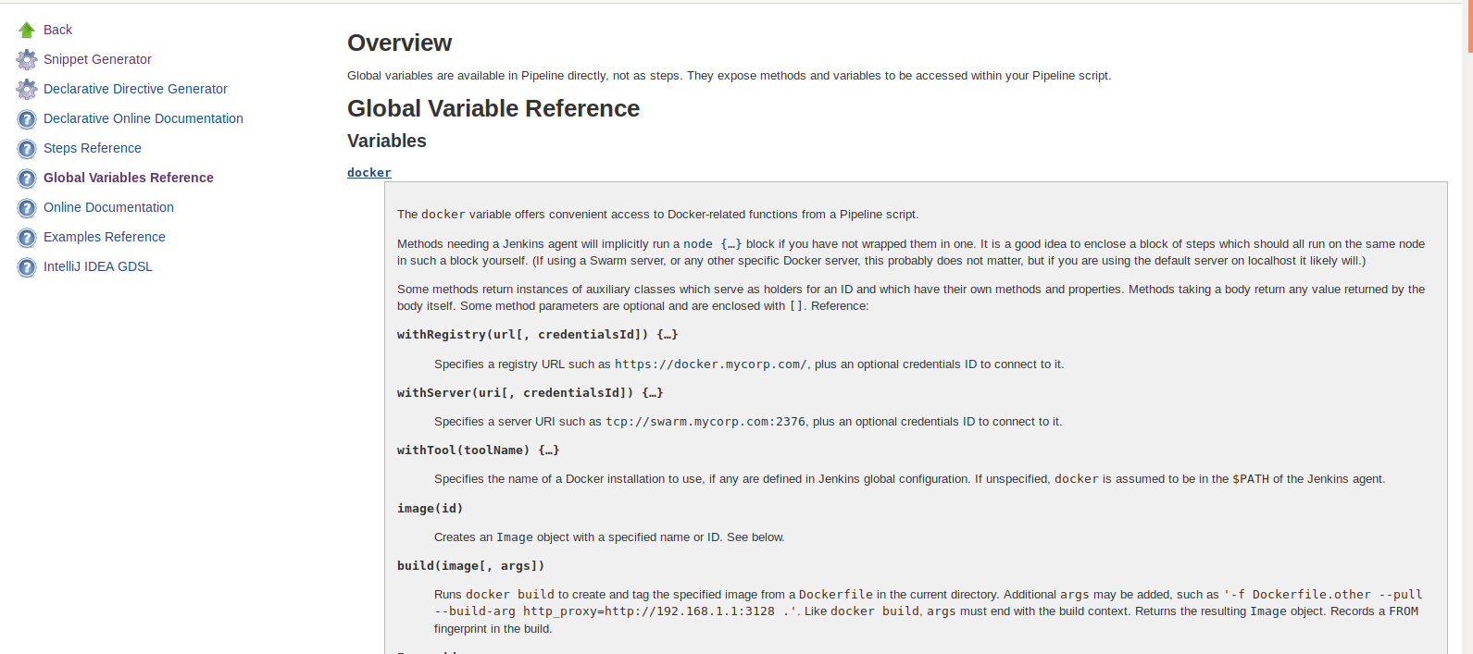
Global Variable Reference
The screenshot below shows the Global Variable Reference page:
Notes:
Trainer Notes: Explain the slide

Slide 63
Declarative Directive Generator

Slide 64
Declarative Directive Generator
The Snippet Generator does not cover the sections and directives used to define a Declarative Pipeline.
The Declarative Directive Generator utility helps generate sections and directives.
The Directive Generator allows you to:
You can then use the generated script in your Declarative Pipeline.
Choose a Declarative directive
Configure it in a form
Generate the configuration for that directive
Notes:
Trainer Notes: Explain the slide and mention the points below
The Directive Generator can generate configuration for nested directives, such as conditions inside a when directive.
It cannot generate Pipeline steps.
The Directive Generator adds a placeholder comment for directives which contain steps, such as steps inside a stage or conditions like always or failure inside pos.
You will still need to add steps to your Pipeline by hand.

Slide 65
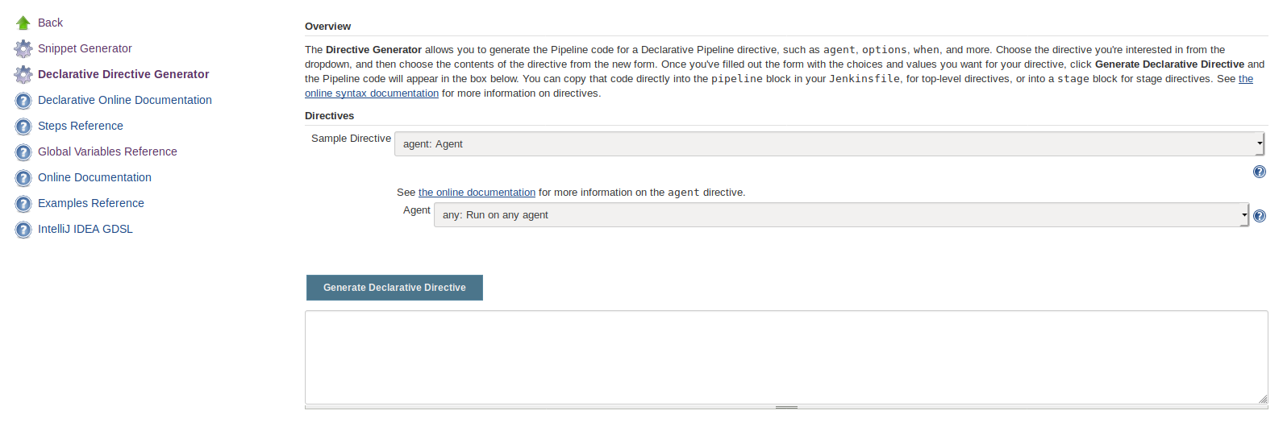
Declarative Directive Generator
The screenshot below shows the Declarative Directive Generator page:
Notes:
Trainer Notes: Explain the slide

Slide 66
Declarative Directive Generator
Steps to generate a Declarative directive using the Declarative Directive Generator:
01
02
03
04
Navigate to the Pipeline Syntax link at ${YOUR_JENKINS_URL}/directive-generator.
Select the desired directive in the dropdown menu.
Use the dynamically populated area to configure the selected directive.
Click Generate Directive to create the directive’s configuration to copy into your Pipeline.
Notes:
Trainer Notes: Explain the slide

Slide 67
Restarting a Pipeline
There are multiple ways to rerun or restart a completed Pipeline:
Replay:
The Replay feature allows for quick modifications and execution of an existing Pipeline without changing the Pipeline configuration or creating a new commit.
Restart from a stage:
You can restart any completed Declarative Pipeline from any top-level stage which ran in the Pipeline. This allows you to rerun a Pipeline from a stage which failed due to transient or environmental considerations.
All inputs to the Pipeline, such as SCM information or build parameters will be the same.
Notes:
Trainer Notes: Explain the slide and mention the points below
Replay:
Usage: Click Replay in the left menu from a previously completed run in the build history.
Restart from a stage:
Usage: You can find the Restart from Stage option in the Blue Ocean UI as well as the Classic UI.

Slide 68
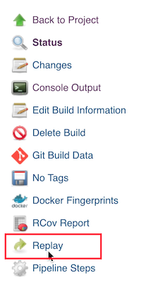
Restarting a Pipeline
The screenshot below shows the Replay option:
Notes:
Trainer Notes: Explain the slide

Slide 69
Restarting a Pipeline
Problem Statement: You have been asked to restart two Pipelines:
one with some modifications
one with no modifications
Steps to perform:
Use the Replay option in a previously completed run from the build history to restart a build with some modifications.
Use the Restart from Stage option in the Blue Ocean UI to restart a build with no modifications.

Slide 70
Pipeline Development Tools
There are many tools and resources that help with development of Jenkins Pipelines. A few are:
Blue Ocean Editor
Pipeline Unit Testing Framework
Command-line Pipeline Linter
Pipeline
Tools
Sublime Text Jenkinsfile package
Eclipse Jenkins Editor
Atom linter-jenkins package
VisualStudio Code Jenkins Pipeline Linter Connector
Notes:
Trainer Notes: Explain the slide

Slide 72
Which of the following is NOT a difference between build jobs and Pipelines?
1
Pipelines are defined using script whereas jobs are defined via the UI.
Freestyle jobs do not create a persistent record of execution whereas Pipelines do.
Pipelines let you store the build results but build jobs do not.
Pipelines let you break jobs into different stages whereas build jobs do not.

Slide 73
Which of the following is NOT a difference between build jobs and Pipelines?
1
Pipelines are defined using script whereas jobs are defined via the UI.
Freestyle jobs do not create a persistent record of execution whereas Pipelines do.
Pipelines let you store the build results but build jobs do not.
Pipelines let you break jobs into different stages whereas build jobs do not.
C
Pipelines and build jobs both let you store the generated artifacts and archive the test results.

Slide 74
Which of the following statement defines a node?
2
A node is a single task in the Pipeline.
A node refers to a distinct subset of tasks performed through the entire Pipeline.
A node is a user-defined model of a Pipeline.
A node is a machine which is part of the Jenkins environment and is capable of executing a Pipeline.

Slide 75
Which of the following statement defines a node?
2
A node is a single task in the Pipeline.
A node refers to a distinct subset of tasks performed through the entire Pipeline.
A node is a user-defined model of a Pipeline.
A node is a machine which is part of the Jenkins environment and is capable of executing a Pipeline.
D
A node is a machine which is part of the Jenkins environment and is capable of executing a Pipeline.

Slide 76
Scripted Pipelines and Declarative Pipelines are both constructed using a Groovy syntax. Is the statement true or false?
3
True
False

Slide 77
Scripted Pipelines and Declarative Pipelines are both constructed using a Groovy syntax. Is the statement true or false?
3
True
False
B
Scripted Pipeline is written in a limited form of Groovy syntax. Declarative Pipelines are constructed differently.

Slide 78
Which of the following methods should you use to run a Pipeline without a new commit but with some modifications?
4
Replay
Restart from a stage

Slide 79
Which of the following methods should you use to run a Pipeline without a new commit but with some modifications?
4
Replay
Restart from a stage
A
The Replay feature allows for quick modifications and execution of an existing Pipeline without changing the Pipeline configuration or creating a new commit.

Slide 80
Jenkins Pipeline is a suite of plugins which supports implementing and integrating continuous delivery Pipelines into Jenkins.
A Pipeline has two main elements: Steps and Stages
A Jenkinsfile can be written using two types of syntax: Declarative and Scripted.
A Pipeline can be built from the Jenkinsfile in the UI or from the committed Jenkinsfile in the SCM.

Slide 81
Multistage Pipeline
Lesson-End Project
Problem Statement:
You’re a DevOps engineer at BookMyEvents, a web- and mobile-based app development company that helps users buy tickets for various events in their cities. The company is moving from a call center-based customer support to a chat and email-based customer support system. The backend developers are developing a Maven project for the new ticketing system which generates a random ticket number for each registered complaint. You’re required to set up a Jenkins pipeline to compile and test the ticket generator. The job has to read the code and the Jenkinsfile from the SCM and then compile and test the code.
Requirements:
The pipeline should be defined as a Jenkinsfile and committed to the SCM.
The pipeline should compile and test the code.
The program should generate a ticket number higher than 1000.
Notes:
Trainer Notes: Explain the project to the learners, and instruct them to perform it after the lesson.

